Slide 1

HPC Operating Committee
Fall 2019 Meeting
November 12, 2019
Meeting Called By: Kyle Mandli, Chair

Slide 2
Introduction
George Garrett
Manager, Research Computing Services
gsg8@columbia.edu
The HPC Support Team
(Research Computing Services)
hpc-support@columbia.edu

Slide 3
Agenda
HPC Operating Committee and Executive Committee
HPC Cluster Updates, Usage Stats, and Expansions
  Terremoto
  Habanero
Data Center Cooling Expansion Update
Upcoming Cluster Update
Business Rules
Support Services and Training
HPC Publications Reporting
Feedback

Slide 4
HPC Operating Committee
The HPC Operating Committee is an open meeting, chaired by Kyle Mandli, that typically meets twice a year to share HPC operating updates and provide a forum to provide guidance, share feedback, and discuss policy.

Slide 5
HPC Operating Committee - Executive Committee
The HPC Operating Committee Executive Committee exists to make decisions swiftly between OC meetings when critical to do so. Membership:
Ryan Abernathey
Jacqueline Austermann
Andrei Beloborodov
Stefano Fusi
Kyle Mandli
Lorenzo Sironi
Alexander Urban

Slide 6


High Performance Computing - Ways to Participate
Four Ways to Participate:
1. Purchase
2. Rent
3. Free Tier (Habanero)
4. Education Tier (Habanero, Terremoto)

Slide 7
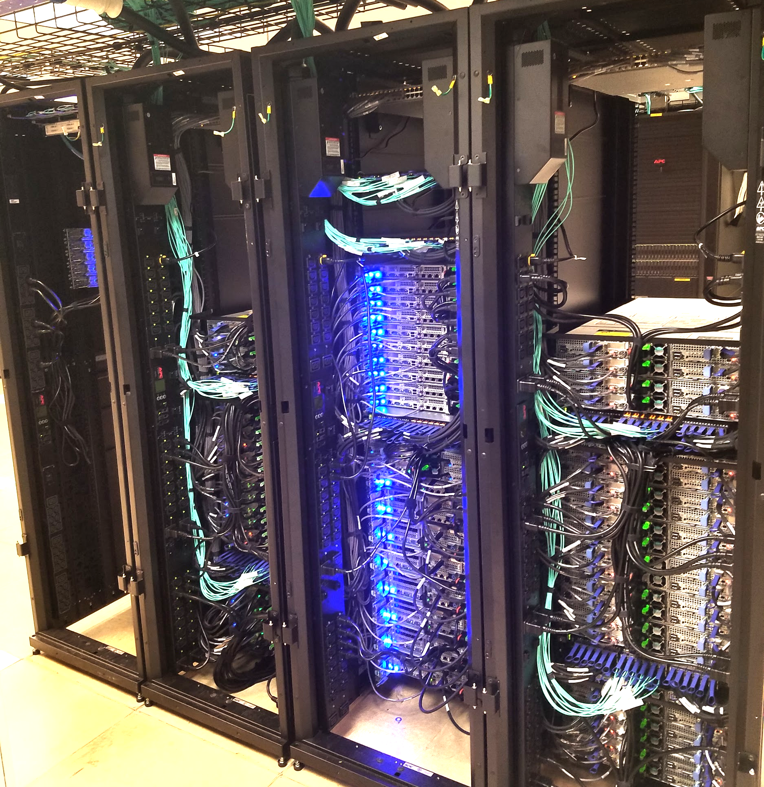
Launched in December 2018
Expanding in December 2019

Slide 8
Terremoto - Expansion
27 Compute Nodes (648 cores)
  19 Standard Nodes
  4 High Memory nodes
  4 GPU nodes with NVIDIA V100 GPUs
80 TB of storage of additional storage
10 Research Groups participated
Terremoto Expansion machines have arrived and will go live in early December 2019.

Slide 9
Terremoto - Participation and Usage
29 research groups
325 users (101 active in past 90 days)
  (135 users added since March 2019)
13.4 million core hours utilized since launch in December 2018
5 year lifetime

Slide 10
Terremoto Specifications - After Expansion
137 Compute Nodes (3,288 cores)
  111 Standard nodes (192 GB)
  14 High Memory nodes (768 GB)
  12 GPU nodes with NVIDIA V100 GPUs
510 TB storage (Data Direct Networks GPFS GS7K)
Dual Skylake Gold 6126 cpus, 2.6 Ghz, AVX-512
100 Gb/s EDR Infiniband
480 GB SSD local drives
Slurm job scheduler

Slide 11
Terremoto - Benchmarks
High Performance LINPACK (HPL) measures compute performance and is used to build the TOP500 list of supercomputers. HPL is now run automatically when our HPC nodes start up.
Terremoto CPU Gigaflops per node = 1210 Gigaflops
  Skylake 2.6 Ghz CPU, AVX-512 advanced vector extensions
  HPL benchmark runs 44% faster than Habanero
  Rebuild your code, when possible with Intel Compiler!
Habanero CPU Gigaflops per node = 840 Gigaflops
  Broadwell 2.2 Ghz CPU, AVX-2

Slide 12
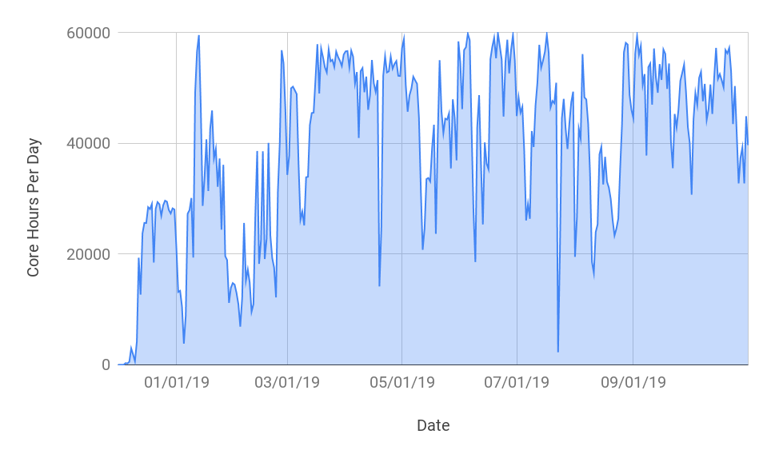
Terremoto - Cluster Usage in Core Hours
Max Theoretical Core Hours Per Day = 63,360
Total core hours used since launch: 13.4 million

Slide 13
Terremoto - Job Statistics
Job Sizes (Last 12 Months)
Cores | 1 - 49 cores | 50 - 249 cores | 250 - 499 cores | 500 - 999 cores | 1000+ cores
Jobs | 193,811 | 880 | 76 | 64 | --
Average Job Size: 17 cores
Median Job Size: 3.1 cores
Average Job Walltime: 5.8 hours
Average Queue Wait Time: 1.8 hours
Median Queue Wait Time: 24 minutes

Slide 14
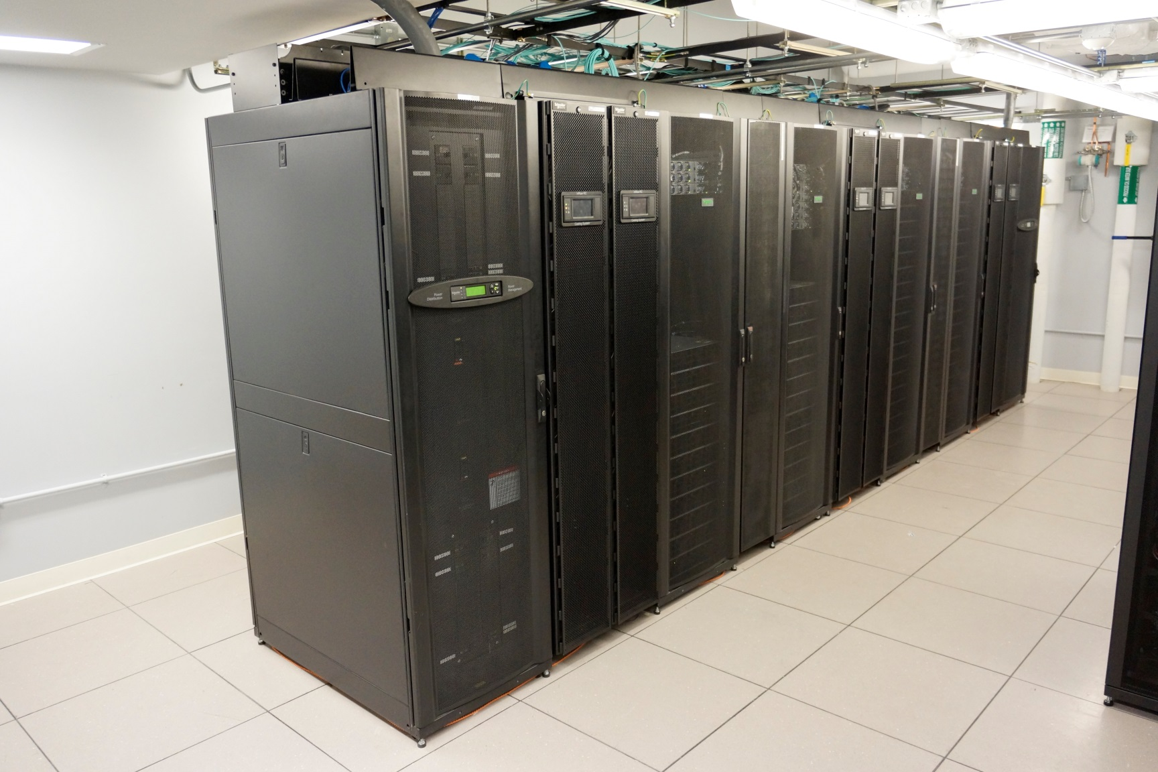
Habanero

Slide 15
Habanero - Specifications
Specs
302 nodes (7248 cores)
  234 Standard servers
  41 High memory servers
  27 GPU servers
740 TB storage (DDN GS7K GPFS)
  Adding 60 TB more in December 2019
Lifespan
222 nodes expire December 2020
80 nodes expire December 2021

Slide 16
Head Nodes
2 Submit nodes
Submit jobs to compute nodes
2 Data Transfer nodes (10 Gb)
scp, rdist, Globus
2 Management nodes
Bright Cluster Manager, Slurm

Slide 17
Habanero - Participation and Usage
44 groups
1,897 users since launch (215 active)
  (347 added since March 2019)
20 renters since launch (5 active)
317 free tier users since launch (33 active)
Education tier
  18 courses since launch (3 added since March 2019)

Slide 18
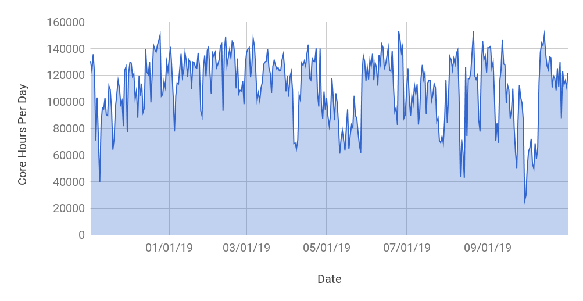
Habanero - Cluster Usage in Core Hours
Max Theoretical Core Hours Per Day = 174,528
Total core hours in past 12 months: 40.7 million

Slide 19
Habanero - Job Statistics
Job Sizes (Last 12 Months)
Cores | 1 - 49 cores | 50 - 249 cores | 250 - 499 cores | 500 - 999 cores | 1000+ cores
Jobs | 812,849 | 1820 | 778 | 256 | 172
Average Job Size: 17.4 cores
Median Job Size: 2.4 cores
Average Job Walltime: 5.4 hours
Average Queue Wait Time: 3.3 hours
Median Queue Wait Time: 2 minutes

Slide 20
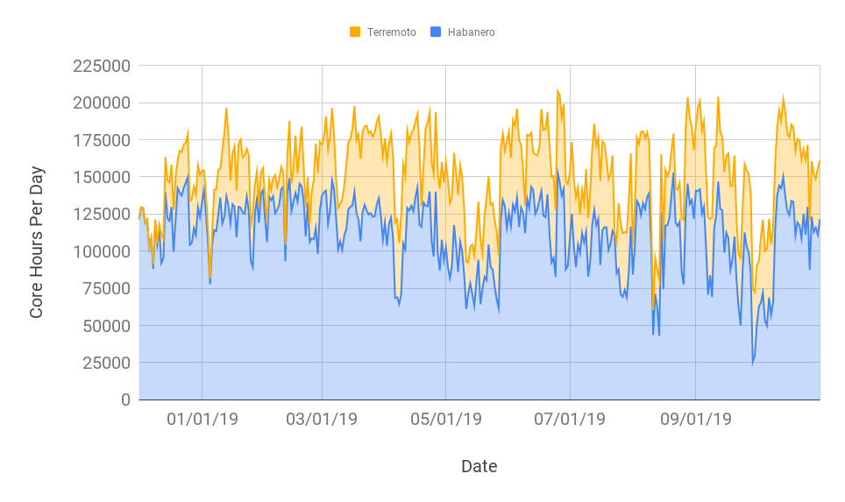
All Clusters - Total Usage in Core Hours
Max Theoretical Core Hours Per Day = 237,888
Total Combined Cluster Core Hours in last 12 months = 54.1 million

Slide 21

HPC Updates (Reminder) - Singularity containers
Singularity
  Easy to use, Docker-like containers for HPC
  Enables reproducibility and complex software stack setup
  Typical use cases
    Instant deployment of complex software stacks (OpenFOAM, Genomics, Tensorflow)
    Bring your own container (use on Laptop, HPC, etc.)
  Planning a workshop for this in Spring 2020.
  Available now on both Terremoto and Habanero!
    $ module load singularity

Slide 22

HPC Updates - HPC Web Portal (Pilot on Terremoto)
Open OnDemand HPC Web Portal
Interactive HPC via your web browser.
Modernization of the HPC user experience.
Get an SSH shell, submit and monitor jobs through your browser.
Open source, NSF funded project.
https://openondemand.org
Piloting on Terremoto. Contact us if interested in trying it out.

Slide 23
Data Center Cooling Expansion Complete
Data Center cooling expansion project was completed in July 2019
A&S, SEAS, EVPR, and CUIT contributed to expand Data Center cooling capacity
Assures HPC capacity for next several generations

Slide 24
Upcoming Cluster Planning - Spring 2020
In planning stages, depending on demand
Announcement typically sent out in April
RFP and new machine types likely
Purchase round to commence late Spring 2020
Go-live in Late Fall 2020
If you are aware of potential demand, including new faculty recruits who may be interested, please contact us at rcs@columbia.edu

Slide 25
Business Rules
Business rules set by HPC Operating Committee.
Rules that require revision can be adjusted.
If you have special requests, such as longer walltime or temporary bumps in priority or resources, contact us. We will forward your request to the HPC OC chair and/or the HPC OC Executive Committee as needed.

Slide 26
Node Priority
Node owners get priority access to the nodes they own.
Public nodes have no priority access.
Habanero Public nodes: 25 total (19 Standard, 3 High Mem, 3 GPU)
Terremoto Public nodes: 7 total (4 Standard, 1 High Mem, 2 GPU)
Notes:
Public nodes: 3 GPU nodes, 3 High Memory nodes, 19 Standard nodes

Slide 27
Job wall time limits
Your maximum wall time is 5 days on nodes your group owns and on public nodes
Your maximum wall time on other group's nodes is 12 hours

Slide 28
12 Hour Rule
If your job asks for 12 hours of walltime or less, it can run on any node across the cluster
If your job asks for more than 12 hours of walltime, it can only run on nodes owned by its own account or public nodes

Slide 29
Fair share
Every job is assigned a priority
Two most important factors in priority
  Target share
  Recent use

Slide 30
Target Share
Determined by number of nodes owned by account. Set to the number of total cores you own.
All members of a group have the same target share

Slide 31
Recent Use
Number of cores*hours used "recently"
Calculated at group and user level
Recent use counts for more than past use
Half-life weight currently set to two weeks

Slide 32
Job Priority
If recent use is less than target share, job priority goes up
If recent use is more than target share, job priority goes down
Recalculated every scheduling iteration

Slide 33
Business Rules
Questions or feedback regarding business rules?

Slide 34
Support Services - HPC Team
6 staff members on the HPC Team
  Manager
  3 Sr. Systems Engineers (System Admin and Tier 2 support)
  2 Sr. Systems Analysts (Primary providers of Tier 1 support)
1081 Support Ticket Requests Closed in last 12 months
  Common requests: onboarding users, how to use the cluster, software requests, job scheduler and business rule inquiries

Slide 35
Support Services
Email support
hpc-support@columbia.edu

Slide 36
User Documentation
hpc.cc.columbia.edu
Click on "Terremoto documentation" or "Habanero documentation"

Slide 37
Office Hours
HPC support staff are available to answer your HPC questions in person on the first Monday of each month.
Where: North West Corner Building, Science & Eng. Library
When: 3-5 pm first Monday of the month
RSVP required: https://goo.gl/forms/v2EViPPUEXxTRMTX2

Slide 38
Training Workshops
Introduction to HPC Workshop Series
Tuesday, January 28th, 2020: Introduction to High Performance Computing, 1:00 p.m. – 2:30 p.m.
Tuesday, February 25th, 2020: Introduction to Linux, 1:00 p.m. – 2:30 p.m.
Tuesday, March 3rd, 2020: Introduction to Scripting, 1:00 p.m. – 2:30 p.m.
Tuesday, March 10th, 2020: Introduction to High Performance Computing, 1:00 p.m. – 2:30 p.m.
For a listing of all upcoming events and to register, please visit:
https://rcfoundations.research.columbia.edu/

Slide 39
Group Information Sessions
RCS support staff can come and talk to your group about your research computing needs.
Topics can be general and introductory or tailored to your group.
Talk to us or contact rcs@columbia.edu to schedule a session.

Slide 40
Additional Workshops, Events, and Trainings
Upcoming Foundations of Research Computing Events
  Including Bootcamps (Python, R, Unix, Git)
  Python User group meetings (Butler Library)
  Distinguished Lecture series
    Feb 13, 2020: Travis Oliphant (Anaconda, Numpy)
Research Data Services (Libraries)
  Data Club (Python, R)
    Provides complimentary programming assistance in Python and R
  Map Club (GIS)

Slide 41
Support Services and Training
Questions about support services or training?

Slide 42
HPC Publications Reporting
Research conducted on Terremoto, Habanero, Yeti, and Hotfoot machines has led to over 100 peer-reviewed publications in top-tier research journals.
Reporting publications is critical for demonstrating to University leadership the utility of supporting research computing.
To report new publications utilizing one or more of these machines, please email srcpac@columbia.edu

Slide 43
Feedback
What feedback do you have about your experience with Habanero and/or Terremoto?

Slide 44
End of Slides
Questions?
hpc-support@columbia.edu

